Slide 1



New science degree collage
At New Science, you are at the heart of everything we do. Without our students, this institution would have no meaning. Your energy, ambition, and success define us.
New Science College is a junior and degree college located in Ameerpet, Hyderabad. It was established in 1970 and offers undergraduate courses in science, commerce, and management.

Slide 2
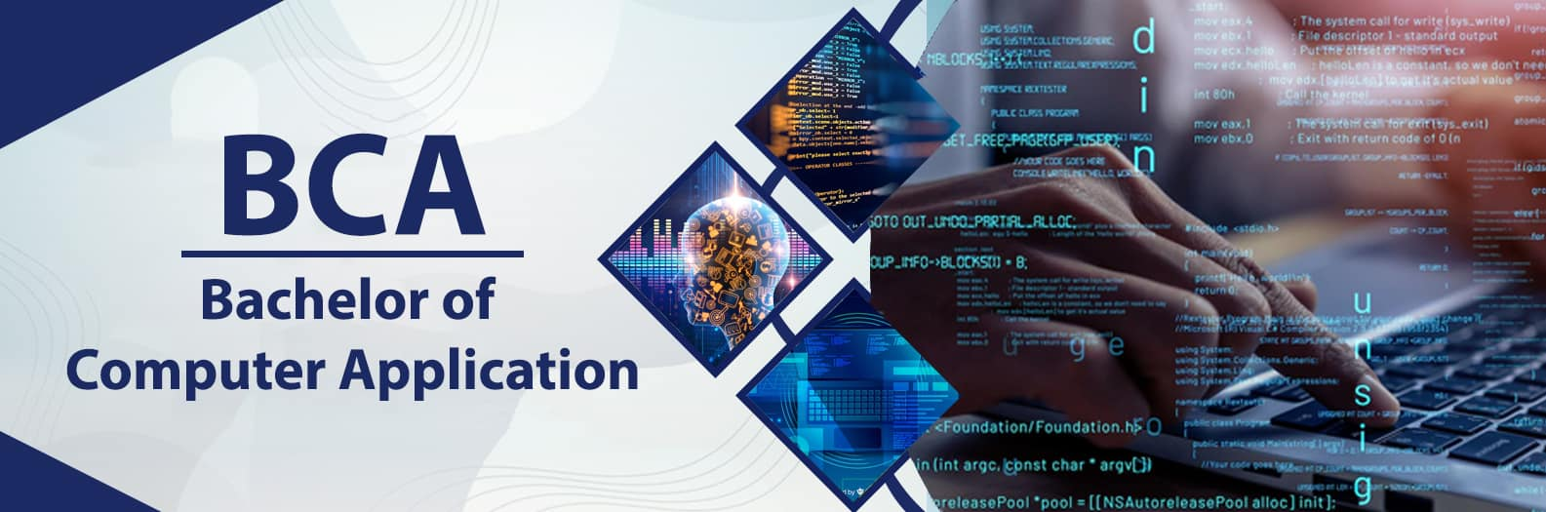
Bachelor of Computer Applications (BCA)
A guide of BCA Course
By: senior Bach

Slide 3

Introduction to BCA
A 3-year undergraduate program Focused on the world of software and Applications.
Introduction To programming languages.
It provides a balanced mix of theory and practical skills, preparing students for both jobs and higher studies.
The course is suitable for students who want to enter the IT field without pursuing engineering (B.Tech).
The BCA course can transform you from a tech user into a tech creator.

Slide 4

About BCA course
The Bachelor of Computer Applications (BCA) is a 3-year undergraduate degree program in computer science and information technology. It was introduced in India during the 1990s to meet the growing demand for IT professionals, with the University of Pune being one of the first to launch it in 1999. The course focuses on programming, software development, databases, and networking, providing students with both theoretical knowledge and practical skills. BCA prepares graduates for careers in the IT industry as well as higher studies like MCA, MBA, or M.Sc. in Computer Science.

Slide 5
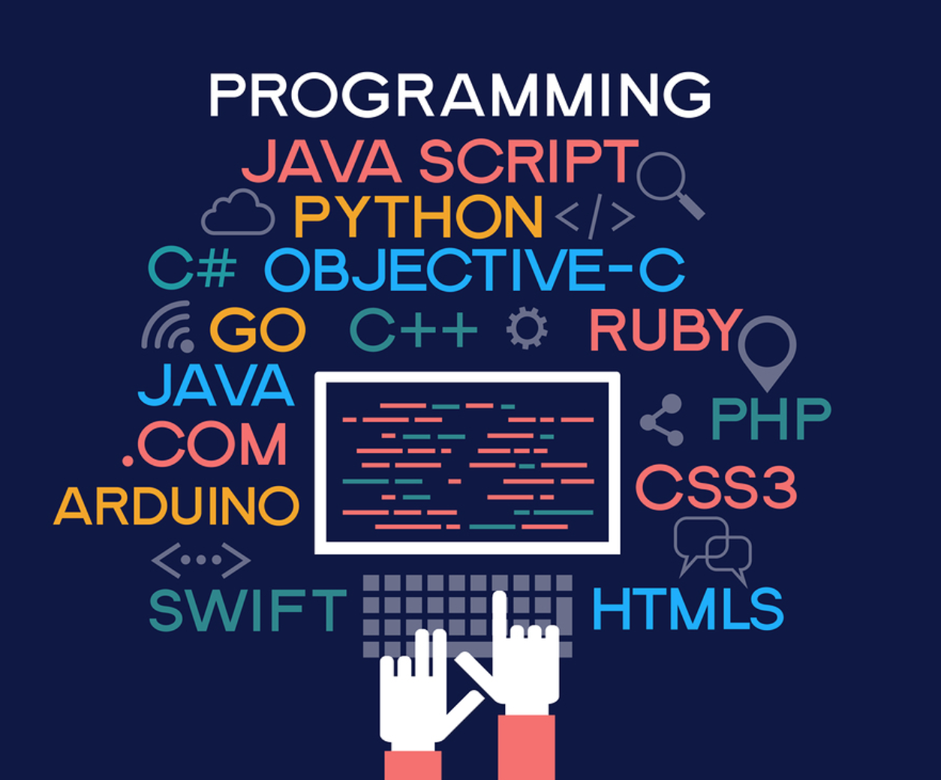


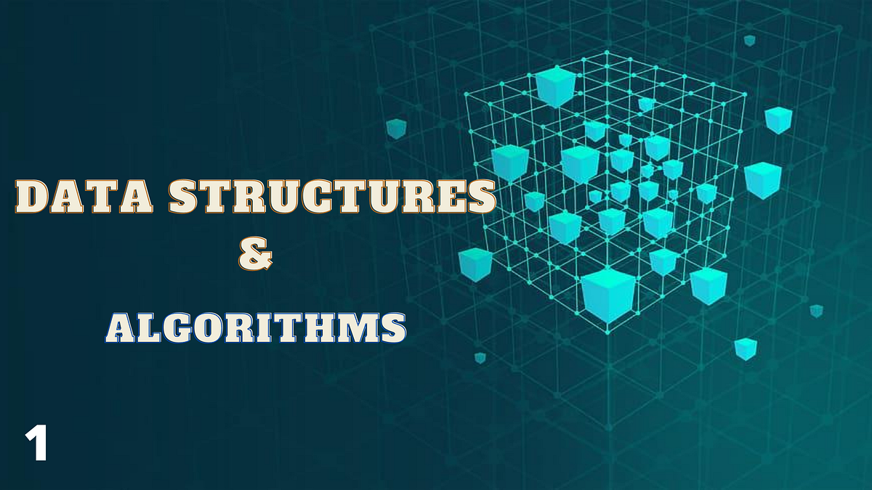
What Will You Learn
Programming Languages: C, C++,Java, Python, .NET
Web Technologies: HTML, CSS, JavaScript, PHP
Mathematics: Discrete Math, Statistics
Data Structures & Algorithms: The logic and brain behind efficient code.thematics: Discrete Math, Statistics

Slide 6

Skills You Gain
Programming & Development Skills
(C, C++, Java, Python ,Object-Oriented Programming (OOPs))
Web Development Skills
(HTML, CSS, JavaScript ,PHP)
Database & Data Skills
(SQL, MySQL, Oracle)
Computer & Networking Skills (Operating Systems, Computer Networks, Cloud Computing, Cybersecurity)

Slide 7
Programming languages
C
C++
Java
Python

Slide 8
.NET
C#
PHP
HTML
SQL

Slide 9

Why Choose BCA?
Provides strong foundation in computer science without heavy engineering focus
Shorter duration (3 years) compared to B.Tech (4 years)
Affordable compared to B.Tech but still offers strong career options
High demand in IT sector with growing career opportunities
Option to specialize in fields like Data Science, Cybersecurity, Cloud, or AI through certifications

Slide 10
Career Opportunities
Software Developer / Programmer
Web& Mobile App Developer
Data Analyst / Database Administrator
Cyber Security Specialist
IT Support / System Administrator

Slide 11


Expanding Your Opportunities with Extra Skills
Artificial Intelligence (Al)
• Automates tasks & improves efficiency
• Huge demand in IT, healthcare, finance, .
Machine Learning (ML)
• Helps in data analysis & decision-making
• Opens careers in Data Science & Analytics

Slide 12


Cloud Computing
•Enables working with scalable IT infrastructure
• In demand by companies like AWS, Microsoft, Google
Cybersecurity
• Protects systems from cyber threats
• Growing need in banking, government, and IT firms

Slide 13
What after BCA?
• MCA (Master of Computer Applications)
• MBA in IT / Business Analytics
• M.SC. (Computer Science, Data Science, AL, Cybersecurity)
• Certifications (Cloud, AWS, Microsoft, Google, etc.)

Slide 14

Questions & Answers
Q1. What is the duration of the BCA course?
Q2. When was the BCA program first introduced in India?
Q3. Which university was the first to implement BCA And which year?
Q4. What are the core subjects taught in BCA?
Q5. What are the career opportunities after BCA?
Q6. What higher studies can be pursued after BCA?

Slide 15

Thank you
Mir MUSTAFA Ali Razvi

